Slide 1
EXPENSE MANAGEMENT SYSTEM
A USER FRIENDLY WEB APPLICATION FOR MANAGING EXPENCES
GROUP - 2
1. | H YASHWANTH
2. | ARPIT SHARMA
3. | ARUL G
4. | SUHAS SHINDE
5. | HARISH MURALI

Slide 2
ABSTRACT
Overview: The Expense Management System is designed to streamline the process of tracking, managing, and analyzing organizational expenses. It helps companies ensure transparency, comply with corporate policies and tax regulations, and eliminate manual monitoring. The system, built using a monolithic architecture, ensures scalability and flexibility by dividing the application into distinct modules such as User Authentication, Expense Management, Category Management, Report Generation, and Notifications. Each module caters to a specific functionality, ensuring the smooth operation of the system.
Key Features:
User Module: Secure user registration, login, and role-based dashboard access with email verification.
Expense Module: Interface for adding, updating, and managing expenses with backend validation.
Category Module: Categorization of expenses with category-wise dashboard and reports.
Category Module: AI-powered categorization of expenses with category-wise dashboard and reports.
Notification Module: Real-time expense notifications and secure backend notification management.
Feedback and Email Notification: AI-driven email/SMS notifications for key events like expense thresholds and user feedback.

Slide 3
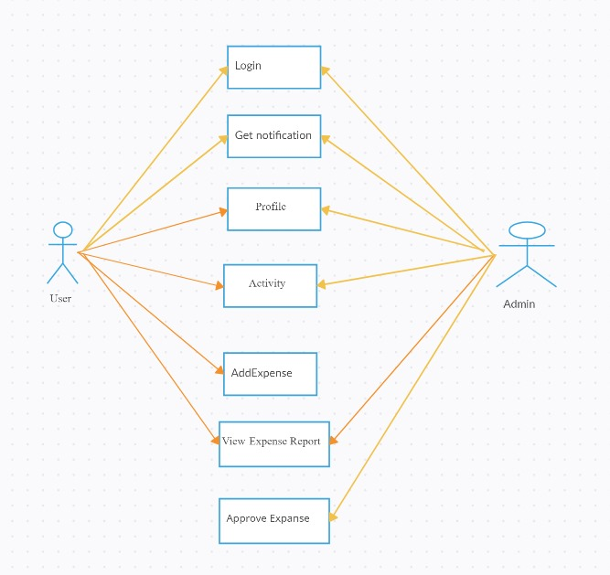
USE CASE DIAGRAM

Slide 4
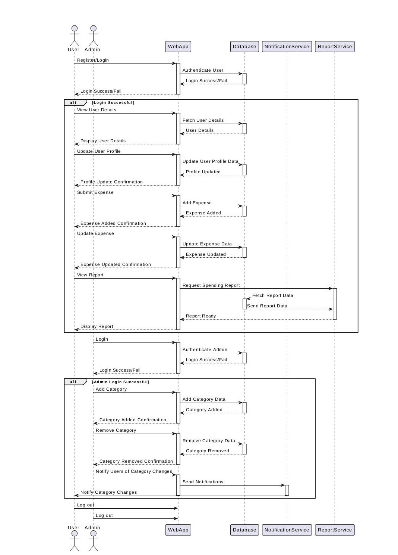
SEQUENCE DIAGRAM

Slide 5
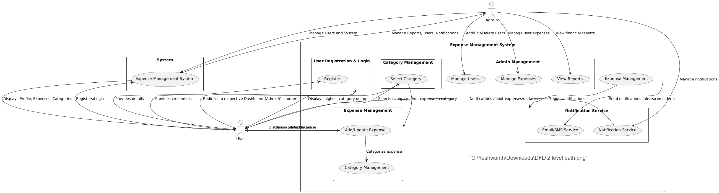
DATA FLOW DIAGRAM

Slide 6
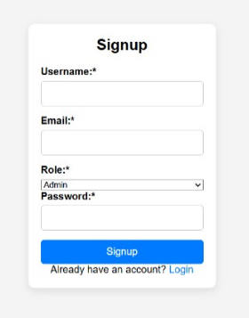
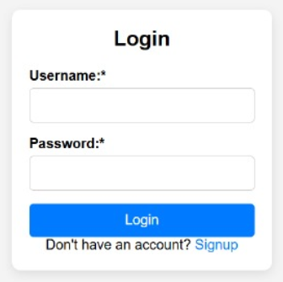
FORM DESIGN

Slide 7
FUTURE ENHANCEMENT
Mobile App Integration: Develop mobile versions of the system for seamless access on smartphones.
AI-driven Analytics: Advanced AI-based insights for predictive expense trends and budget forecasting.
Multilingual Support: Add support for multiple languages for global usage.
Customizable Dashboards: Provide more user-specific customization options on dashboards for better insights.

Slide 8
CONCLUSION
The Expense Management System offers an efficient, scalable, and secure solution for organizations to manage their finances. By automating tasks like expense tracking, reporting, and notifications, it reduces manual effort and improves accuracy. The system's architecture allows future scalability and the integration of advanced technologies like AI and Blockchain, making it an indispensable tool for modern businesses seeking to optimize their expense management processes.

Slide 9


